Slide 1
Student Database Administration
By Anjana Devi Jauli Krishnamoorthy

Slide 2
Technologies used
MYSQL DB
Maven
Lombok annotations
Spring Boot Microservices
Spring Data JPA
AssertJ
HTML, CSS and Bootstrap
Spring Security and Spring Validation

Slide 3
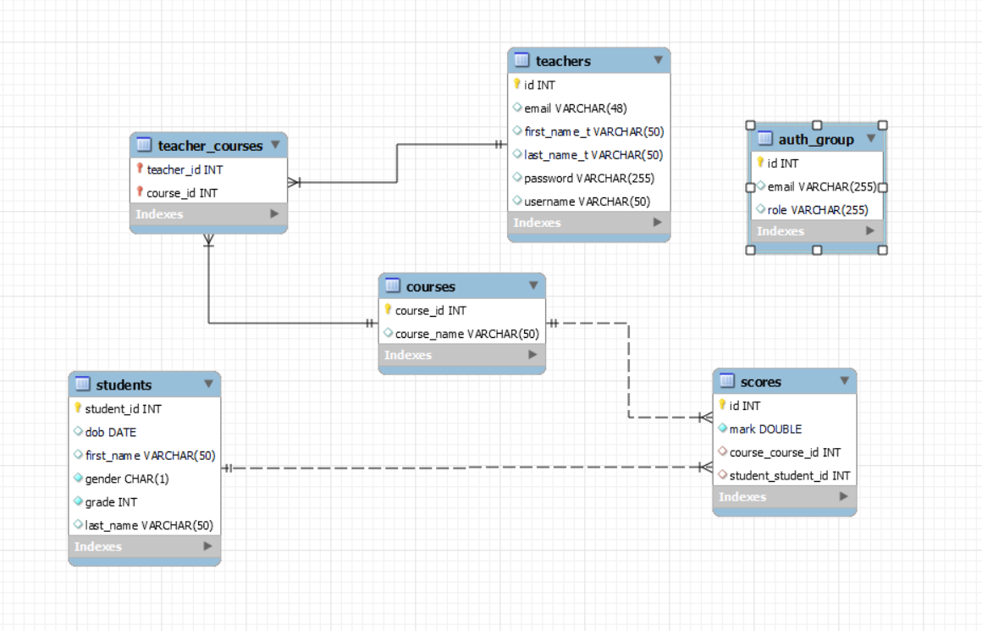
ER Diagram

Slide 4
Functionalities of the Webpage
• Add, edit, or delete students, teachers, and courses. • Search student by their id or with their first name and last name. • View students by grade and find the number of girls, boys, and total count. • View or update course assigned to a student. • Add exam score for each course and generate performance report. • Assign students to enhancement or tuition according to their performance. • Assign teachers to courses. • Teacher and course are in many to many relationship. • One teacher can be assigned to more than one course. • One course can be taken by more than one teachers. • Prevent deleting a teacher if the teacher is assigned to a different course. • Prevent deleting a course if the same course is assigned to a different teacher. • Prevent adding same course or teacher or student if already exist in database

Slide 5
Roles and Permissions
1) As a admin, users can perform all CRUD operations on students, teachers, and courses, as well as create and delete teacher-course assignments. Username: anjana@gmail.com Password:password
2) As a teacher, users can view all students and update their scores, as well as view student performance reports. Based on student performance, teachers can recommend students for specialized learning or assign them to tutoring. Username: ashley@gmail.com Password:password

Slide 6
Thank you!

